Slide 1
Housing EDA
Marco Kan

Slide 2
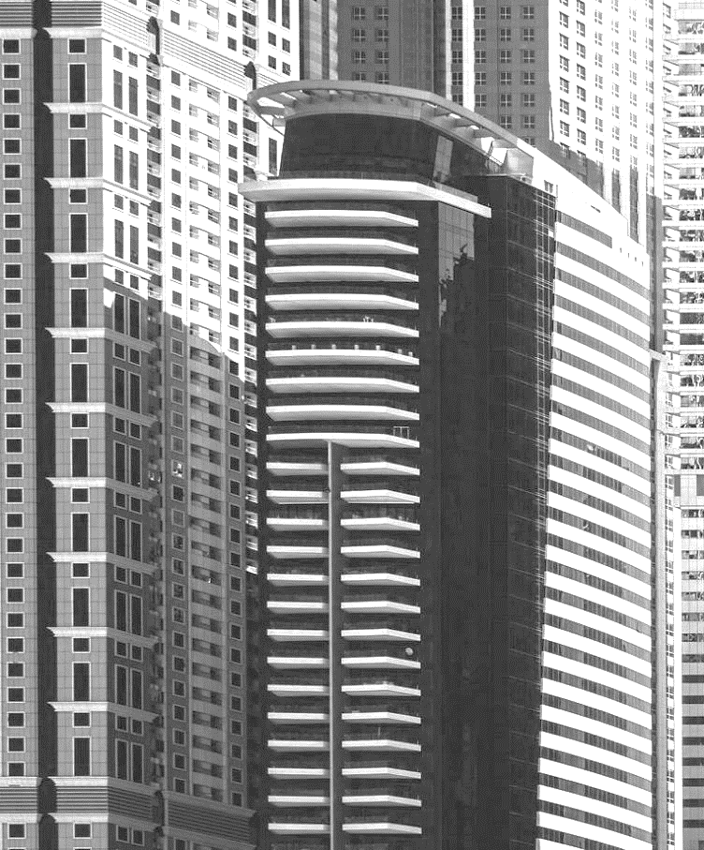

AGENDA
INTRODUCTION
Hypothesis 1
Hypothesis 2
Hypothesis 3
Client Case Study – Nicole

Slide 3

INTROduction
I will present 3 Hypothesis for the Housing Data in Kings County, Seattle Washington in America and present my finding. This will be followed by a client case study, Nicole, to help her find a suitable house based on her requirements

Slide 4
Hypothesis
Hypothesis 1:
Higher grade houses usually mean larger houses
Hypothesis 2:
The condition of the house depends on the year it was built
Hypothesis 3:
Areas that are less central have larger houses

Slide 5
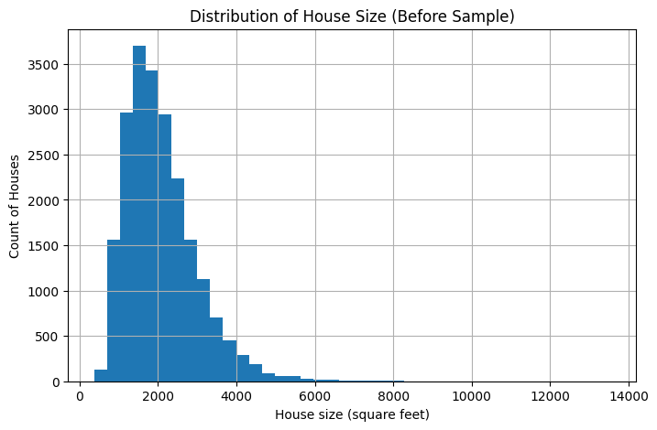
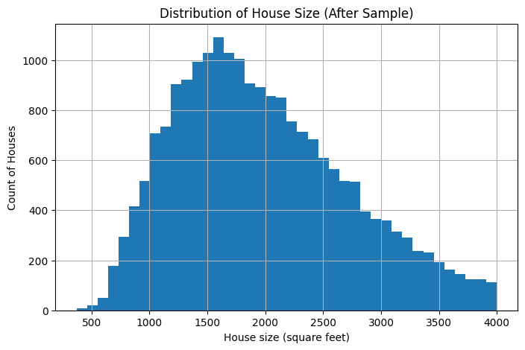
Sample Data – House size
- The House Size data were not evenly distributed with and would heavily change the results
- Sample data was taken to reduce extreme values
Original Dataset
Sample Data
With the sample data we kept 96% of the original dataset

Slide 6
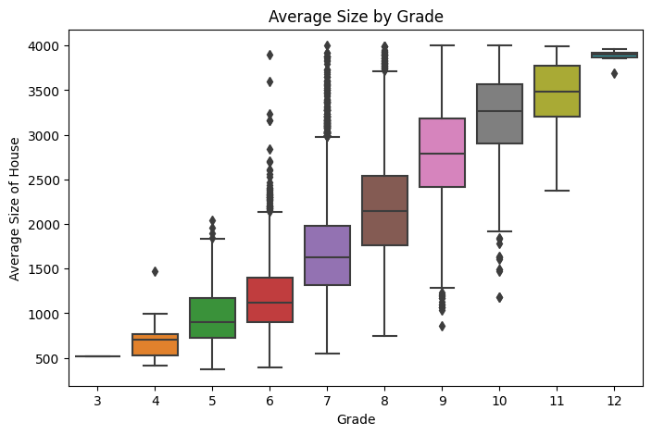
Hypothesis 1
Kings County House Grading
3 = Below building standards
Higher grade houses usually mean larger houses
13 = Custom Luxury houses
Boxplot:
Positive correlation between the average house size & grading
The bigger the house, the better the grading
The average house sizes are graded around 7-8

Slide 7
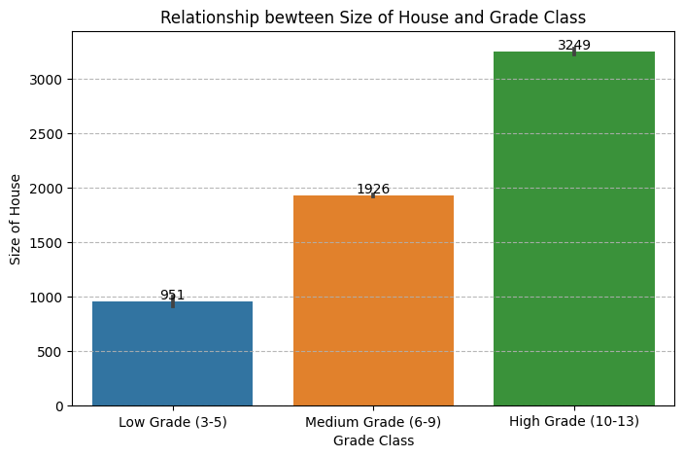
Hypothesis 1 - continued
Split grading into:
Low Grade (3-5)
Medium Grade (6-9)
High Grade (10-13)
Each average house size of category each category increases steadily
Pearson’s Correlation:
76% - strong correlation

Slide 8

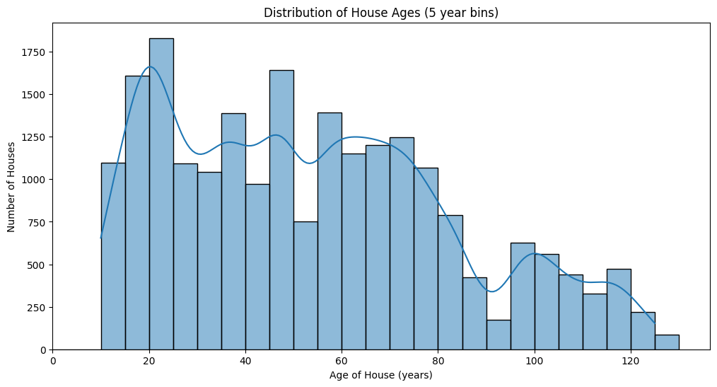
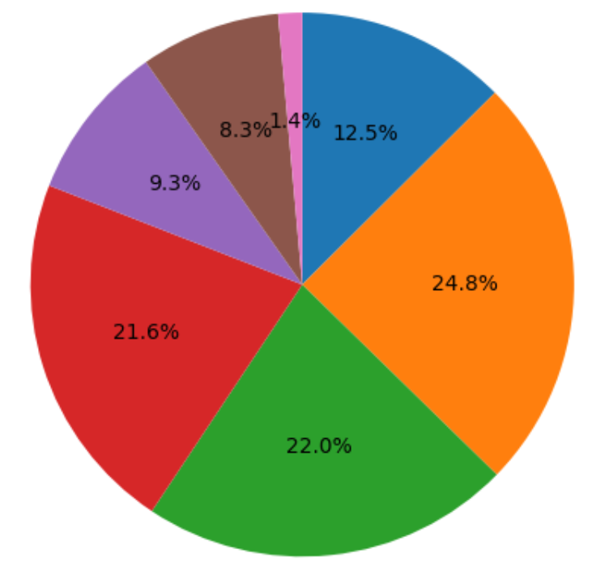
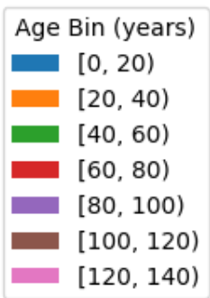
Hypothesis 2
The condition of the house depends on the year it was built
Distribution of House age
The data is NOT evenly distributed – 67% of the houses are between 20-80 years old

Slide 9
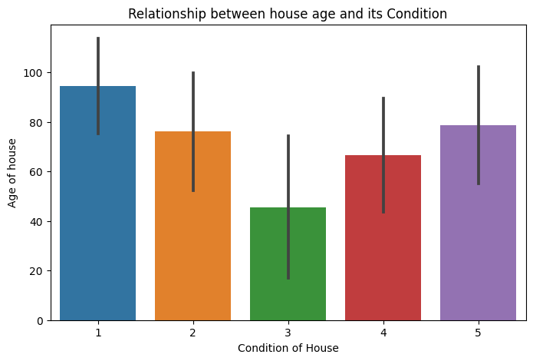
Hypothesis 2 - Continued
House Condition is rated from 1-5 with 1 being the worst
Bar Chart:
There is no positive relationship between the age of the house and its condition
- Old houses doesn’t mean they are in bad condition.
- New houses has an average condition
Spearman’s Correlation:
39% - weak correlation

Slide 10
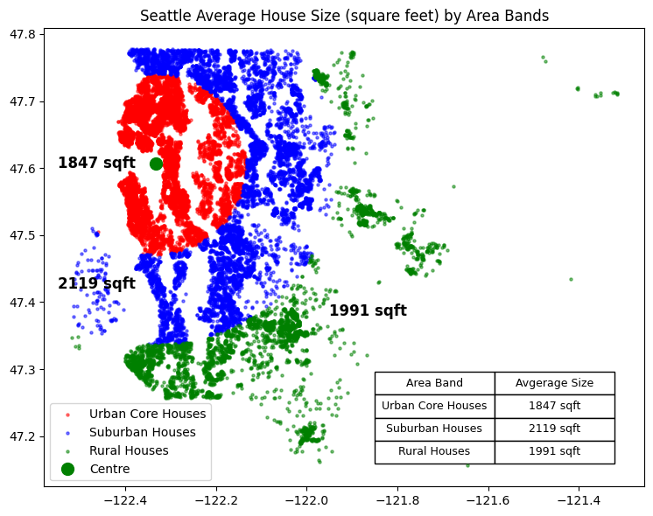
Hypothesis 3
Areas that are less central have larger houses
Distance to centre - 3 area bands:
Urban – 0-15km
Suburban – 15-30km
Rural – >30km
Zip codes of Seattle were considered when dividing areas
Table shows suburban houses have on average the largest houses
The centre point coordinates recorded

Slide 11
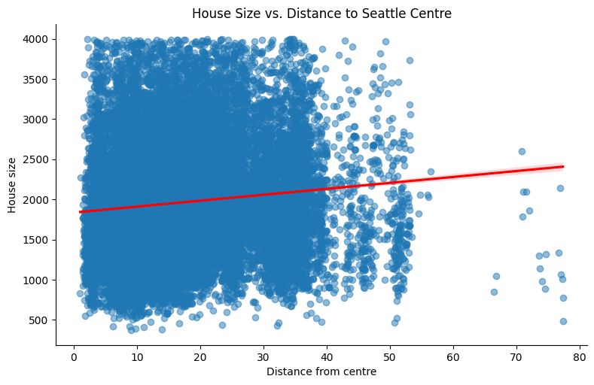
Hypothesis 3 - Continued
Scatterplot:
No relationship between the house size and the distance from centre.
Being further out doesn’t mean the houses are significantly larger.
In fact, largest houses are in the suburban areas.
Pearson’s Correlation:
24% - very weak correlation

Slide 12
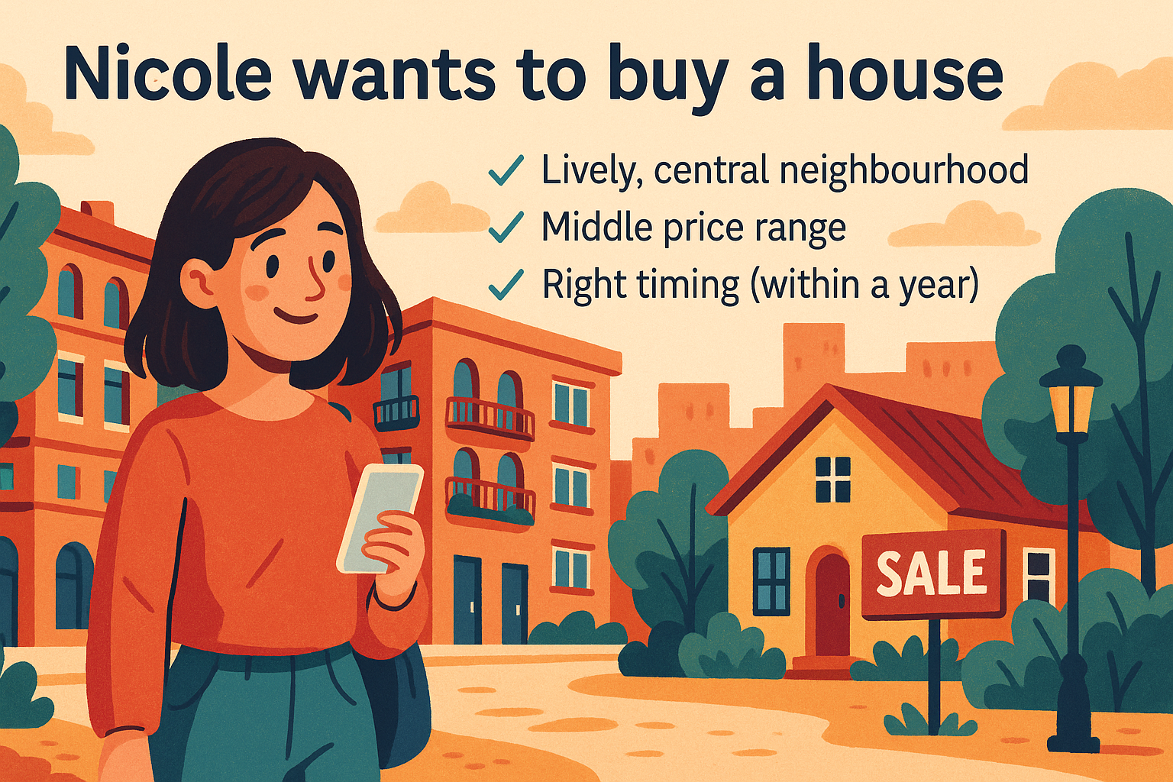

Slide 13
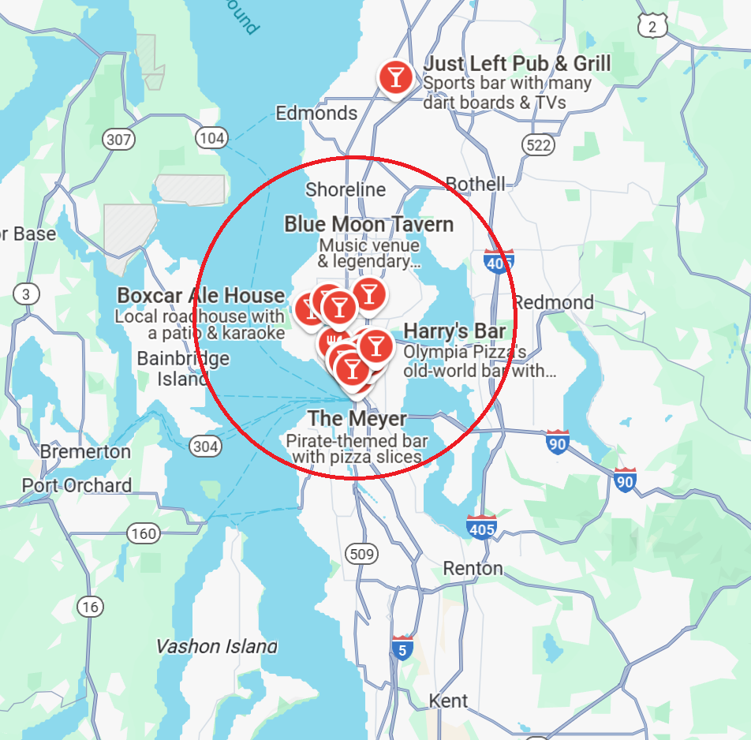
Lively CENTRAL NEIGHBOURHOOD
Bar, Restaurants, Activities
Filter the search using the zip codes within this central area:
- Ballard / Shilshole
- Fremont / Wallingford / Green Lake
- Central District / Madison Valley
- Capitol Hill / Eastlake
- UW District / Laurelhurst
- Queen Anne
- South Lake Union
- Madison Park / Washington Park
Narrows search to 2,008 houses

Slide 14
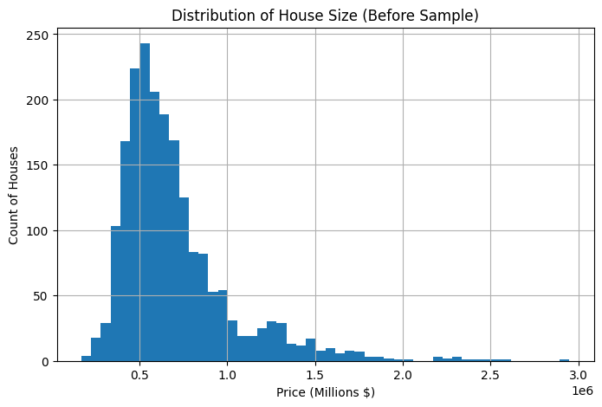
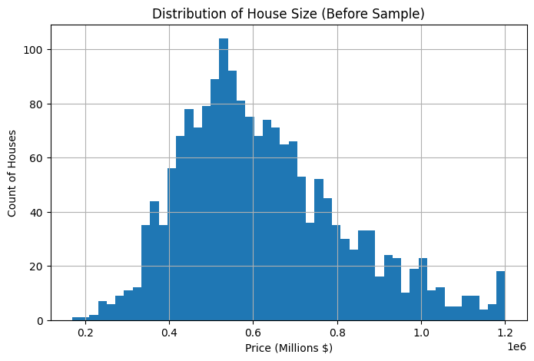
Sample Data - Price
- Once again, Price data was not evenly distributed within these zipcodes
- Around 200 houses were creating this unbalance
Original Dataset
Sample Data
With the sample data we kept 91% of the original dataset – Narrows search to 1,837 houses

Slide 15
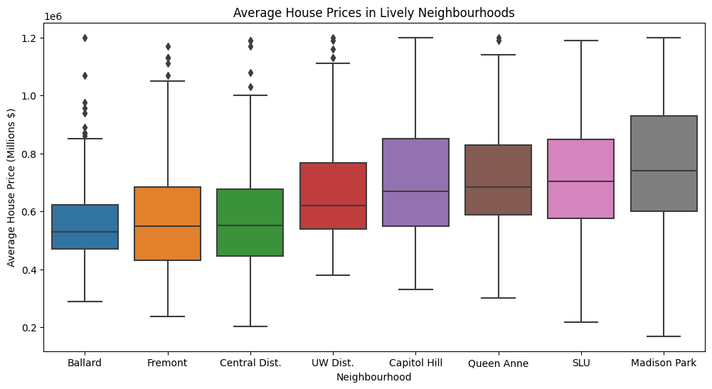
Middle Price Range of lively area
Area | Average Price
Ballard | $558,899
Fremont | $569,754
Central District | $580,152
UW District | $671,308
Capitol Hill | $707,213
Queen Anne | $708,382
SLU | $717,316
Madison Park | $765,073
Results show that Fremont and Central District has the price range closest to the median of $595,000
Narrows search to 869 houses

Slide 16
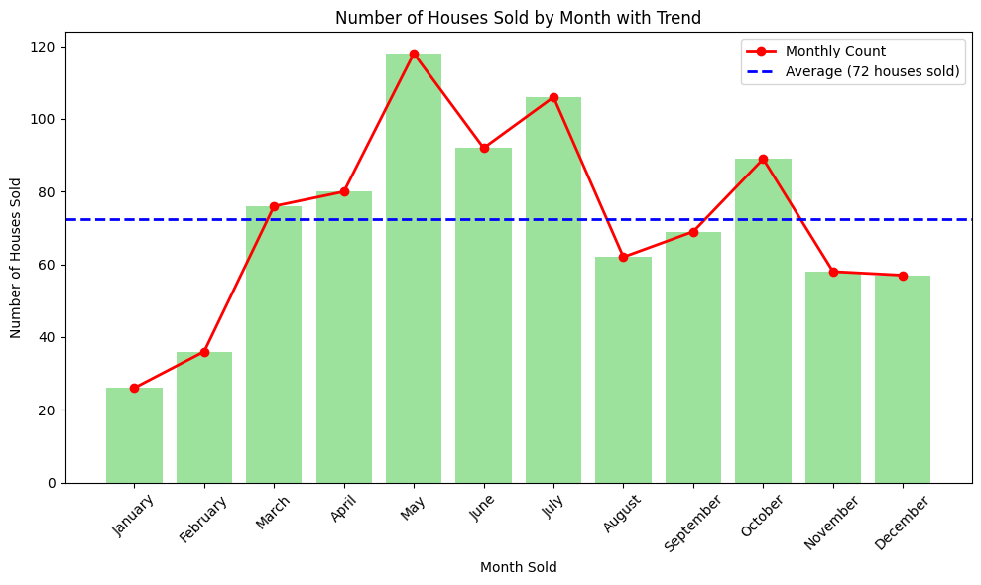
Buy Within a year
On average, 72 houses are sold each month
Within these 2 neighbourhoods, between 2014-2015, May is the time most houses are sold and January is the least. This shows it could be a seasonal cause.
For Nicoles requirements, it is best to buy in the districts Fremont and Central District with a budget of $595,000 in May

Slide 17
THANK YOU for listening
Marco Kan

